Slide 1
ACEND® 2022 Accreditation Standards and Nutrition and Dietetics Graduate Program Accreditation Standards Overview
For Faculty and Preceptors
Notes:
Welcome to the ACEND 2022 and Nutrition and Dietetics Graduate Program Accreditation Standards Overview for Faculty and Preceptors.
This training is intended as a supplement to faculty and preceptor trainings provided by our ACEND-accredited program as an orientation to ACEND and the role of faculty and preceptors, like yourselves, in the accreditation process. Use of this training should assist our program in partially complying with Required Element 5.2.c. which states: “Program faculty and instructors must be provided orientation to the mission, goals and objectives of the nutrition and dietetics program, the ACEND Standards and required knowledge and competencies. Program faculty must be trained in the use of distance education pedagogy and recommended practices.”

Slide 2
Objectives
As a result of completing this training, you should be able to do the following:
Explain ACEND’s relationship to The Academy and its role in the accreditation process
Describe the roles of the program director, faculty and preceptors in the accreditation process
Identify key ACEND 2022 and Future Education Model (FEM) Accreditation Standards and Required Elements that are relevant to faculty and preceptors
Notes:
As a result of completing this training, you should be able to:
Explain ACEND’s relationship to The Academy of Nutrition and Dietetics and its role in the accreditation process
Describe the roles of the program director, faculty and preceptors in the accreditation process, and
Identify key ACEND 2022and Future Education Model, or FEM, Accreditation Standards and Required Elements that are relevant to faculty and preceptors.

Slide 3
About ACEND
Notes:
ACEND is the acronym for the Accreditation Council for Education in Nutrition and Dietetics. ACEND is recognized by the US Department of Education, or USDE, as the accrediting body for nutrition and dietetics education programs. This means that ACEND is approved to create a set of accreditation standards that programs must follow in order to be considered an accredited nutrition and dietetics education program. Every five years the USDE reviews ACEND to ensure that it is meeting the USDE criteria for accreditors. This is essentially a self-study report and site visit process for ACEND.
In a similar manner, ACEND reviews its own accredited programs every seven years to ensure that they meet the ACEND standards. ACEND uses a peer-review process to assure the quality of its programs. ACEND program review teams conduct site visits to programs that want to continue their accreditation, in order to assess whether those programs meet the ACEND Accreditation Standards. The ACEND Board of Directors, which is made up of educators, practitioners, student members and public members, review the recommendations from these teams and make all accreditation decisions as a group. So, when it’s time for our program to write the self-study report and have the site visit, we’ll invite our faculty and preceptors to participate. Basically, when the review team arrives on site, they are here to confirm what we have written in the self-study report. They’ll do that through observation, tours and meetings with program stakeholders such as yourselves. It is a peer-reviewed quality assurance process. The review team brings their findings back to the ACEND Board who then determines the accreditation decision for our program.

Slide 4
Academy Relationships
Academy of Nutrition and Dietetics
ACEND
BOD
CDR
Accrediting Agency for Nutrition and Dietetics Education Programs
Board of Directors of The Academy, the professional member organization
Credentialing Agency for Nutrition and Dietetics Practitioners
Notes:
I’d like to explain ACEND’s relationship to the Academy of Nutrition and Dietetics. The Academy is a legally incorporated, not-for-profit corporation. It is a professional membership organization that provides products and services to its members and strives to empower members to be food and nutrition leaders. The Board of Directors oversees the strategic direction, budget, guidelines and policies of The Academy of Nutrition and Dietetics.
Although a part of The Academy’s not-for-profit corporation, ACEND is required by the US Department of Education to function autonomously from both the Academy and the Commission on Dietetic Registration, also known as CDR. All decisions made about accreditation standards and our program’s accreditation status are made by the ACEND Board without interaction or influence by either The Academy or CDR. CDR is also a part of The Academy’s not-for-profit corporation. It too functions autonomously from The Academy and ACEND in making credentialing decisions.

Slide 5
ACEND Accreditation Standards
Define minimum levels of quality
Basis for accreditation decisions
Applied equally to all programs
Revised on a routine basis (every 5 years)
2022 Standards implementation: June 1, 2022
Notes:
Accreditations Standards are central to the accreditation process. These standards define the minimum levels of quality allowed for an accredited program in good standing. All accreditation decisions are made by the ACEND Board and are based on the Standards; they are applied equally to all programs.
The ACEND Standards were created by educators, regulators, practitioners, students and the general public. They are revised on a routine basis, generally every five years, or more often as needed. The 2022 Accreditation Standard were implemented June 1, 2022 and programs were to adopt them and implement them with their incoming cohort.

Slide 6
ACEND Accreditation Standards
Notes:
ACEND has four sets of standards under the 2022 Accreditation Standards that are required for US based programs and one program type for foreign education programs.
They include the
Nutrition and Dietetics Coordinated Programs (CP)
Nutrition and Dietetics Internship Programs (DI)
Nutrition and Dietetics Didactic Programs (DPD)
Nutrition and Dietetics Technician Programs (DT) and the
Foreign Dietitian Education Programs (FDE)
The Coordinated Programs are those programs that include both the didactic coursework and the supervised practice hours in one program. The Didactic Program in Dietetics only includes the didactic or coursework portion. The Dietetic Internship program includes only the minimum 1000 hours of supervised practice requirement; therefore, interns must have a DPD verification statement in order to apply to dietetic internship programs. These program types are programs that will lead to the RDN credential.
The Dietetic Technician program has both the coursework and supervised practice hours; however, graduates of DT programs are eligible to sit for the NDTR exam. Graduates of DT programs must complete one of the previously mentioned programs that include supervised practice to be eligible for the RDN exam if they are interested.
ACEND removed the international dietetic education program type and Incorporated the IDE Standards into the 2022 CP Standards. Now international programs that wish to lead to the RDN credential with the new 2022 standards can apply as CP programs if they meet the CP requirements. With the change, the requirement that IDE programs must have 900 hours in the US was removed and programs can now provide those hours in the country where the program is housed or in the United States.
ACEND also has standards for the Foreign Dietitian Education programs or FDE programs. In addition to dietetic coursework, FDE students must complete a minimum of 500 hours of supervised practice in the host country. FDE graduates are not eligible to sit for the CDR credentialing exam until they perform supervised practice in the United States.

Slide 7
Future Education Model Accreditation Standards
https://www.eatrightpro.org/acend/accreditation-standards-fees-and-policies/future-education-model-standards-and-templates-v2022
©ACEND 2022
Notes:
ACEND has also developed the Future Education Model standards, or FEM standards, for graduate and associate degree programs. The FEM programs are available for voluntary adoption. These programs differ from the 2022 Accreditation Standards because these programs are degree-based, while the 2022 Standards include program types.

Slide 8
ACEND Accreditation Standards
Similarities and Differences in Standards
2022 Standards | Future Education Model Standards-Reformatted
8 Standards for each program type CP, DPD, DI, DT, FDE Available for all programs | 8 Standards for each program type Associate (AP) and Graduate (GP) No credential for associate’s degree Available for demonstration programs only
©ACEND 2022
Notes:
With the release of the 2022 Accreditation Standards, the FEM standards were reformatted so that they are very similar to the 2022 Accreditation Standards except for the curriculum standards. Here are a few key differences between the two sets of standards
All currently accredited DPD, DI, CP, DT and FDE programs will continue under the 2022 Standards and ACEND will continue to accredit all of these program types. There has been no decision to end the accreditation of any of the program types.
The Future Education Model Accreditation Standards are available only for those who apply and are accepted to be a demonstration program either through the candidacy process or as a reorganization of an existing ACEND accredited program.
There is no credential for graduates of the Nutrition and Dietetics Associate degree program. As employment opportunities demonstrate consistent responsibilities for these graduates, at that point CDR would start to investigate creating a credential.

Slide 9
Organization of the Standards
1: Program Characteristics and Resources
2: Program Mission, Goals, Objectives and Program Evaluation and Improvement
3: Curriculum and Learning Activities
4: Assessment and Curriculum Improvement
5: Faculty and Preceptors
6: Supervised Practice/Experiential Learning Sites
7: Information to Prospective Students and the Public
8: Policies and Procedures for Enrolled Students
©ACEND 2022
Notes:
Now I‘d like to introduce you to how the Accreditation Standards are organized. There are 8 accreditation standards in both the 2022 and FEM Standards.
The standard number, title and text of the standard are listed and below each standard are the required elements that apply to the standards. The Required Elements are the specific statements that describe the components of the standards that need to be met. When each of the required elements is met, then the program is considered in compliance with that standard.
The bolded standards, Standards 3, 4 and 5, have the most relevant information for faculty and preceptors so we’ll review these standards in detail.

Slide 10
Role of Program Director (RE 1.5)
Manages compliance with ACEND requirements
Delegates data collection to faculty and preceptors
Compiles and analyzes student outcome data
Coordinates submission of all ACEND reports
Ensures faculty and preceptors are appropriate for subject area
Ensures faculty and preceptors are trained on program procedures and ACEND standards
with ACEND requirements
Notes:
I’d like to summarize the roles that the Program Director, faculty and preceptors play in ACEND accredited programs. Program directors manage all of the duties related to maintaining compliance with the ACEND Standards. They may delegate tasks to faculty and preceptors, such as data collection, and ensure these individuals have adequate knowledge of the topics they teach, as well as understand program policies and the ACEND Standards. They are also responsible for reporting data to ACEND at least annually and at the end of the program’s seven-year accreditation cycle. Required Element 1.5 lists additional Program Director duties in detail.

Slide 11
Role of Faculty and Preceptors
“Boots on the Ground”
Implement and assess specific assignments and activities in courses or rotations
Track student outcomes on specific assignments and provide data to program director
Participate in trainings provided by program
Provide program director with CV or other professional information to confirm experience and qualifications
Include KRDNs and CRDNs on syllabi and rotation descriptions
on the Ground”
Notes:
Faculty and Preceptors are the “boots on the ground” for a program. That is to say, faculty and preceptors implement many of the learning experiences that afford students or interns the opportunity to gain knowledge and skills throughout the program. Program Directors rely on faculty and preceptors to conduct fair assessments of their students and interns, alert the Program Director to any problems and track outcomes on certain assignments and experiences to help the program director demonstrate student or intern achievement. There are also administrative tasks, such as providing a CV or ensuring knowledge and competencies are included on course or rotation syllabi, that help the program stay in compliance with the ACEND Standards.

Slide 12
Standard 3: Curriculum and Learning Activities – 2022 Accreditation Standards
Notes:
Standard 3 contains all of the requirements for an ACEND-accredited program’s curriculum. I will discuss each required element in this standard, as Faculty and Preceptors are the primary individuals responsible with implementing curriculum. First, I will address Standard 3 in the 2022 Standards, then will address Standard 3 in the Future Education Model Standards.

Slide 13
Abbreviations
CRDN – Competencies for Registered Dietitian Nutritionist (CP, DI, FDE, GP)
KRDN – Knowledge for Registered Dietitian Nutritionist (CP, DPD, FDE, GP)
CNDT – Competencies for Nutrition and Dietetic Technicians (DT)
KNDT – Knowledge for Nutrition and Dietetic Technicians (DT)
Notes:
Before we discuss the 2022 and Future Education Model ACEND Accreditation Standards, I’d like to review a few abbreviations that you will hear me say during this presentation.
Knowledge and Competencies are the core items that must be included in an ACEND-accredited Nutrition and Dietetics Education program. These knowledge and competencies are different between RDN and NDTR programs, and therefore have different abbreviations. For example, CRDNs are the competencies for preparing registered dietitian nutritionists and KNDTs are the knowledge statements for preparing nutrition and dietetics technicians, registered. I will provide more detail about the knowledge and competencies in Standard 3.
There are many more abbreviations that ACEND-accredited programs use. ACEND posts a guidance information document on its website that includes these abbreviations as well as a glossary of terms.

Slide 14
Standard 3
Required Element 3.1: Curriculum Components
Required Element 3.2: Curriculum Map
Required Element 3.3: Learning Activities
Notes:
Standard 3 has three required elements.: Curriculum components, the curriculum map and learning activities. I will discuss each required element in this standard, as Faculty and Preceptors are the primary individuals responsible with implementing curriculum.
One change to Standard 3 in the 2022 standards is that a concentration is no longer an ACEND requirement for DIs, CPs, and Individualized Supervised Practice Pathways, or ISPPs; however, programs can always choose to have a concentration and keep or add program specific competency statements, if they wish.

Slide 15
Standard 3: Curriculum and Learning Activities
Required Element 3.1: Curriculum Components
Knowledge and skills needed to enter supervised practice (DPD),
Or, become an entry-level practitioner:
Registered dietitian nutritionist (CP, ISPP, DI);
Nutrition and dietetics technician, registered (DT);
Dietitian (FDE)
Notes:
This required element contains all of the topics and skills that must be included in the curriculum of an ACEND-accredited program. The program’s curriculum must be designed to ensure the breadth and depth of requisite knowledge and skills needed for: entry-level practice as a registered dietitian nutritionist (CP, ISPP, DI, IDE); nutrition and dietetics technician, registered (DT); dietitian (FDE); or entry to supervised practice to become a registered dietitian nutritionist for (DPDs)

Slide 16
Required Element 3.1: Curriculum Depth and Breadth
Required Components (3.1.a)
Core Knowledge and Competencies (3.1.b)
Notes:
Required Components are broad topics that make up the foundation of an ACEND-accredited classroom curriculum. These topics can be covered in prerequisite courses, non-program courses or professional courses or in supervised practice. Since the 2022 Standards do not require a didactic component in Dietetic Internships, the Required Components template is not requested from Dietetic Internship programs.
I mentioned the Core Knowledge and Core Competencies earlier by their abbreviations, KRDNs, CRDNs, KNDTs and CNDTs. These are specific pieces of knowledge and skills that students and interns must learn and then be assessed on for proficiency. Before completing the program, a student MUST demonstrate that they have attained the required knowledge and/or achieved competence for each KRDN and CRDN, or KNDT and CNDT, depending on the program type. The program must ensure that graduates have attained the knowledge and/or competency skill sets prior to awarding a verification statement to a student or intern.

Slide 17
Required Element 3.1: Curriculum Depth and Breadth
Faculty
Required Components
Core Knowledge (KRDNs, KNDTs)
Alternate Supervised Practice Hours
Using role play, case studies, simulation or non-professional work site activities to achieve competencies
CP, DT, degree-based DI only
Preceptors
Competencies (CRDNs, CNDTs)
Notes:
Generally, faculty are responsible for teaching the broad topics included in the required components and the core knowledge required by ACEND, while preceptors generally cover the core competencies.
However, there are some exceptions to this rule if programs decide to use alternate supervised practice hours. Alternate supervised hours use activities outside of a supervised practice setting, such as role play, case studies and simulations that enable students or interns to learn skills that promote achievement of competence. Faculty of CP, DT, or DI programs that include a degree may be asked to provide these alternate supervised practice activities in didactic course work.

Slide 18
New/Revised Required Components (CP, DPD, FDE)
 | Required Component
2 | Communication and documentation skills sufficient for entry into professional practice
5 | Principles of medical nutrition therapy, the Nutrition Care Process, and clinical workflow elements
10 | Licensure and certification in the practice of nutrition and dietetics
11 | Individual National Provider Identifier (NPI)
14 | Added global nutrition
15 | Removed nutritional genomics (CP, FDE)
16 | Cultural humility, self-reflection, and diversity, equity and inclusion
17 | Human behavior, psychology, sociology or anthropology
Notes:
There are many required components so we will not go through each one during this training; however, I will discuss a few revised or newly added required components in the 2022 standards. Since there are many required components, please refer back to the standards to read all more thoroughly.
Under Required Component #2, the words documentation skills were added to the communication skills needed for entry into professional practice.
Under #5, clinical workflow elements were added. There is a definition for clinical workflows in the guidance document which states “The sequence of processes that are performed within a healthcare establishment, including both administrative and clinical work. For example, it could be: the workflow between a doctor, dietitian or patient/client or the workflow performed during a patient/client visit, or the workflow of healthcare information in electronic or paper formats among people at a clinical practice”
Required Component #10 was added which states Licensure and certification in the practice of nutrition and dietetics.
Obtaining an Individual National Provider Identifier (NPI) number in component 11 was added; Global Nutrition was added to the language under Required Component 14.
For the CP and FDE programs in Required Element 15, the term nutritional genomics was removed.
For Required Components 16 and 17, ACEND reworded and separated the requirements for cultural humility, self-reflection, diversity, equity and inclusion from human behavior, psychology, sociology or anthropology. Note that for this last component, it is an OR statement so it can be any of the following, human behavior, psychology, sociology OR anthropology.
Again, these topics need to be covered somewhere in the curriculum and so are not need to be included as a full course. For example, faculty can likely include the NPI component in a Counseling Course.

Slide 19
New/Revised Required Components (DT)
 | Required Component
7 | Principles of applied food science, food safety and sanitation and principles and techniques of food preparation
15 | Cultural humility, self-reflection, and diversity, equity and inclusion
16 | Human behavior, psychology, sociology or anthropology
Notes:
These are changes made to the DT required components.
Similar to the CP, DPD, FDE, For Required Components 15 and 16, ACEND reworded and separated the requirements for cultural humility, self-reflection, diversity, equity and inclusion from human behavior, psychology, sociology or anthropology.

Slide 20
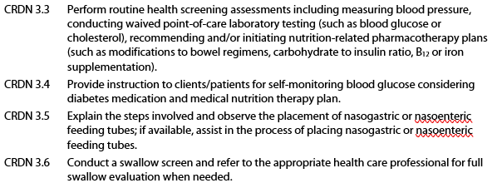
Clinical Skills CRDNS
GUIDANCE
Programs must either have KRDN 3.4 and CRDNs 3.3-3.6 implemented by June 1, 2022 or programs must show evidence of plans for implementation such as meeting minutes where implementation is discussed. After December 31, 2023 programs must have these competencies fully implemented within the curriculum.
Notes:
One of the changes to the competencies and knowledge requirements was the addition of the clinical skills which are CRDNs 3.3-3.6 and KRDN 3.4. They are noted here for your reference. Programs must either have the competencies 3.3-3.6 and knowledge requirement 3.4, depending on the program type, implemented by June 1, 2022 or programs must show evidence of plans for implementation such as meeting minutes where implementation is discussed. Therefore, we intend to include our faculty and preceptors in the discussions regarding the addition of these new clinical skills.

Slide 21
Clinical Skills Competencies Examples
CRDN 3.3/KRDN 3.4: Perform/Practice routine health screenings
Performed with a real-life patient or simulation or students/ interns perform these on other students/interns
CRDN 3.4: Provide instructions for self-monitoring blood glucose
Performed with real-life patients, in an outpatient group classroom setting, or in a simulation
CRDN 3.5: Explain the steps and observe the placement of a nasogastric or nasoenteric feeding tube
Observation done in a real setting or recording, and students/ interns can then explain the steps to someone else
CRDN 3.6: Conduct a swallow screen and refer to appropriate professional for full swallow evaluation
Interview a patient (or simulated patient) with screening questions and then identify the need for full swallow evaluation
Notes:
ACEND has provided examples about the specific clinical skills competencies that were added to the 2022 standards. However, our program may choose to fulfil these in various other ways as well.
CRDN 3.3/KRDN 3.4: Perform/Practice routine health screenings
Performed with a real-life patient, simulation or students or interns perform these on other students or interns
CRDN 3.4: Provide instructions for self-monitoring blood glucose
Performed with real-life patients, in an outpatient group classroom setting or in a simulation
CRDN 3.5: Explain the steps and observe the placement of a nasogastric or nasoenteric feeding tube
Observation done in a real setting or recording, and then students or interns can explain the steps to someone else
CRDN 3.6: Conduct a swallow screen and refer to appropriate professional for full swallow evaluation
Interview a patient (or simulated patient) with screening questions and then identify the need for full swallow evaluation

Slide 22
Required Element 3.2: Curriculum Map
How is the curriculum organized?
Does it logically and sequentially move from introductory to more advanced learning activities?
For program types that offer supervised practice, does the curriculum culminate in experiences to demonstrate entry-level competence?
Notes:
Our program determines how the curriculum is organized, but it must include logical and sequential progression of coursework or competency attainment. For program types that offer supervised practice, the curriculum must culminate in experiences to demonstrate entry-level competence.

Slide 23
Required Element 3.2: Curriculum Map
Required Element 5.1
©ACEND 2022
Notes:
As program director, I may share with you, or ask your help in updating, the curriculum map for the program.
The curriculum map must reflect the CRDNs/KRDNs/CNDTs/ noted on the Core Competency and/or Core Knowledge Assessment Table, which I will discuss shortly. In addition, the curriculum map may also reflect the knowledge requirements and/or competencies that are relevant in courses or rotations as determined by our program. The curriculum map does not need to include courses outside of the accredited program.
All programs are required to submit this template to ACEND in various reports.

Slide 24
Curriculum Map
Required Element 5.1
©ACEND 2022
Notes:
We list all the courses and/or rotations in the program on the left-hand side of the template. Then, we’ll place an X where the KRDN or CRDN is covered according to the Core Competency or Core Knowledge Assessment Table. We may determine that the knowledge requirements and/or competencies are relevant in other courses or rotations and mark those as well. It is helpful to have more than one course or rotation indicated for each knowledge requirement or competency. If a student or intern fails to attain the knowledge or competency in one course or rotation, then we can look at the curriculum map and assess knowledge or competence in another course or rotation for that student or intern.
As a program director, I really appreciate the support from faculty and preceptors to identify alternate means for a student or intern to show that they have attained the knowledge or met the competency.

Slide 25
Required Element 3.3: Learning Activities
Must include:
Various conditions and disease states, specified for RDN students/interns
Various populations, including specific age groups
Diverse cultures
Must use a variety of educational approaches
3.3c: Learning activities on DEI
3.3d1: Addition for distance education-ensuring substantive interaction with students
Notes:
Required Element 3.3 describes what types of learning activities are required by ACEND. Our program must ensure students or interns learn about a variety of conditions and disease states, populations and cultures within the curriculum. Additionally, our program must include a variety of educational approaches within the curriculum, such as case studies, interdisciplinary teamwork and hands-on skill building, to facilitate learning for individuals with different learning needs.
In Required Element 3.3c, the 2022 Standards now have a requirement to address diversity, equity and inclusion. Our program must describe how we will ensure that our students, or interns, are gaining the skills in DEI. So, I will work with the faculty and preceptors to ask for the activities that are being used or any evaluations that you are doing with our students or interns.
In Required Element 3.3d1: the Standards state that programs with distance education are required to have substantive interaction between students and instructors. USDE defines substantive interaction as engaging students in teaching, learning and assessment consistent with the content and must include two of the following: either direct instruction, providing feedback on coursework, responding to questions and/or facilitating group discussions.

Slide 26
Summary of Learning Activities Template
REQUIRED TEMPLATE
©ACEND 2022
Notes:
ACEND requires that our program submit a summary of these learning activities in a required template. I’ll likely ask faculty and preceptors for examples of a learning activity from your course or rotation that is associated with a population or disease state, or request that you include a specific activity within your course or rotation so that all students or interns are exposed to the same information or skill building. I really appreciate the support of faculty and preceptors in helping to meet this requirement.
I’ll also need to provide a variety of different examples of learning activities used within our program. As a reminder to faculty, please be sure to include the learning activity noted in the Summary of Learning Activities Template on your syllabus and/or rotation description as appropriate.

Slide 27
Standard 3: What to Expect from the Program Director Faculty: Discussion of learning activities to assess knowledge (KRDN, KNDT) Explanation of any competencies (CRDN, CNDT) covered Preceptors: Program-specific Rotation Description (or help creating) Program-specific rubrics/assessment materials Discuss student and preceptor expectations
R 244
G 135
B 75
#F
Notes:
ACEND asks that I, as program director, be in regular communication with the faculty and preceptors participating in the education of our students or interns. As a faculty member of the program, you should expect that I will discuss the following with you:
-Any learning activities from your course used to assess KRDNs or KNDTs, and
-Whether activities in your course will be included as alternate supervised practice hour activities to assess the CRDNs or CNDTs.
To our preceptors, I am to provide a program-specific rotation description and assessment materials for the students or interns you are training. In some cases, you may be working with me to create these rotation descriptions and assessment materials. You and I should also discuss what is expected of both the student or intern and the preceptor during the rotation so that the appropriate student or intern experience is provided. Even though you may have materials from another supervised practice or supervised experiential learning program, it is important that each program provide its own materials to preceptors. Those of you who are precepting students from multiple programs must use the assessment materials from the program a student attends, not materials from any other institutions you may be working with. This ensures that students or interns from the same program all receive comparable educational experiences.

Slide 28
Standard 3: Curriculum and Learning Activities – FEM Accreditation Standards
Notes:
Having addressed Standard 3 for the 2022 Standards, I’ll now address Standard 3 in the Future Education Model Accreditation Standards.

Slide 29
Abbreviations
CRDN – Competencies for Registered Dietitian Nutritionist (CP, DI, FDE, GP)
PI – Performance Indicators (GP)
Notes:
While the Future Education Model Standards include competencies similar to those found in the2022 Standards, the FEM Standards also include Performance Indicators, or PIs. A performance indicator is a quantitative or qualitative measurement, or any other criterion, by which the performance, efficiency or achievement, of a person can be assessed, often by comparison with a standardized measure or target.

Slide 30
Standard 3: Curriculum and Learning Activities
Required Elements
RE 3.1 –
Curriculum map
RE 3.2 –
Learning Activities
Notes:
Standard 3 addresses the curriculum map and the learning activities in the program.

Slide 31
Standard 3: Curriculum and Learning Activities
Competencies are the basis for the curriculum
Development of competencies must be done throughout the curriculum
Didactic coursework and supervised experiential learning must be integrated throughout the curriculum
Syllabi must include the competencies being assessed in the course
Experiential
Learning
Didactic
Notes:
This standard 3 is different from the 2022 accreditation standards. It states that the competencies must be the basis on which the curriculum is built and demonstration of competence must be integrated in the coursework and supervised experiential learning, or SEL, activities throughout the program.
The take-away point here is that SELs are woven throughout the curriculum so that competence can be demonstrated several times and not just at the end of the program.
Key points include:
The competencies are the basis of the curriculum
The competencies have to be covered and developed throughout the curriculum
Experiential learning needs to be integrated throughout the curriculum
Syllabi that are part of the academic unit must include the competencies that are assessed in that course

Slide 32
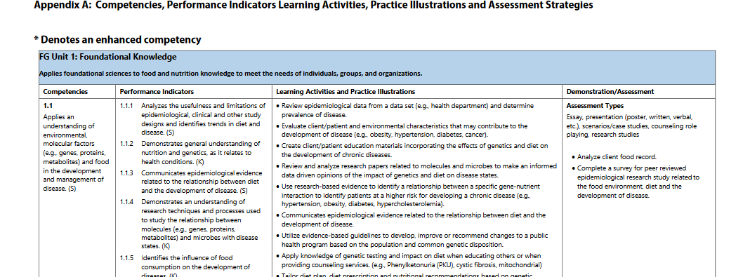
Appendices of Guidance Information Document
Performance Indicators
Practice Illustrations
Competencies
Assessment
Notes:
Appendix A in the standards includes the competencies, PIs, practice illustrations, and examples of types of assessments. These can also be found in the guidance information document.
As you see here, for FEM graduate programs, the competencies are listed in the first column followed by the performance indicators. One difference between the FEM standards and the 2022 standards is that the PIs are used to show when students achieve the competency. You will see a number of ACEND provided PIs for each competency. The practice illustrations give examples of learning activities that could be incorporated into the program as well as assessment methods. This can be very useful when our faculty and preceptors are developing learning activities for the students.

Slide 33
Competency Mapping
J
u
d
g
m
e
n
t
K
n
o
w
l
e
d
g
e
S
k
i
l
l
s
Performance in Practice
Does
Demonstration
of Learning
Shows
Miller’s Competency Assessment Pyramid
Fact Gathering
and Interpretation
Knows
Color codes used in the curriculum map
Notes:
The FEM standards follow the Miller’s assessment pyramid model. We ask that a student Knows, Shows or Does something so that competence is assessed.
Knows refers to fact gathering and interpretation
Shows refers to the demonstration of learning, in a lab, through an assignment or other active activity
Does refers to performance in actual practice

Slide 34
Curriculum Map Template
Key elements:
Must cover all PIs in the curriculum
PIs do not need to be “assessed.” They must be “incorporated” or “covered”
…incorporated in the curriculum through learning activities, assessment (e.g., projects, case studies, presentations, exams) and supervised experiential learning, and covered in textbooks and coursework to prepare students to demonstrate the required competencies.
Notes:
Here are some key elements for the curriculum for our faculty to be aware of:
It is important that all the PIs in the curriculum are addressed in the curriculum map.
All performance indicators do not have to be assessed, but they have to be incorporated in the curriculum through learning activities, supervised experiential learning, or assessments such as projects, case studies, presentations, or exams, and covered in textbooks and coursework to prepare students to demonstrate the required competencies.

Slide 35
RE 3.2 Learning Activities
Must include:
Various conditions and disease states
Various populations, across the life cycle
Diverse cultures
Clinical skills
Must use a variety of educational approaches
Notes:
The learning activities must include:
Various conditions and disease states.
The populations students in graduate programs will work with include learning activities with individuals or populations across the life cycle and with diverse cultures.
Additionally, the program must include learning experiences for several clinical skills.
The program also must use a variety of educational approaches to facilitate different learning styles of the students.

Slide 36
Clinical Skills Learning Experiences
GUIDANCE
Programs must either have learning experiences associated with e.1-4 implemented by June 1, 2022 or programs must show evidence of plans for implementation such as meeting minutes where implementation is discussed. After December 31, 2023 programs must have these learning experiences fully implemented within the curriculum.
Notes:
The FEM GP Standards include clinical skills which are learning experiences e.1-4. They are noted here for your reference. Programs must either have the learning experiences e.1-4 implemented by June 1, 2022 or programs must show evidence of plans for implementation such as meeting minutes where implementation is discussed. Therefore, we intend to include our faculty and preceptors in the discussions regarding the addition of these new clinical skills.

Slide 37
Clinical Skills Learning Experiences-Examples
Required Element (RE) 3.2.e.1:
Perform routine health screenings
Performed with a real-life patient or simulation or students perform these on other students
RE 3.2.e.2: Provide instructions for self-monitoring blood glucose
Performed with real-life patients, in an outpatient group classroom setting, or in a simulation
RE 3.2.e.3: Explain the steps and observe the placement of a nasogastric or nasoenteric feeding tube
Observation done in a real setting or recording, and students can then explain the steps to someone else
RE 3.2.e.4: Conduct a swallow screen and refer to appropriate professional for full swallow evaluation
Interview a patient (or simulated patient) with screening questions and then identify the need for full swallow evaluation
Notes:
ACEND has provided examples about the specific clinical skills competencies that were added to the 2022 standards. However, our program may choose to fulfil these in various other ways as well.
Required Element (RE) 3.2.e.1: Perform routine health screenings
Performed with a real-life patient or simulation or students perform these on other students
RE 3.2.e.2: Provide instructions for self-monitoring blood glucose
Performed with real-life patients, in an outpatient group classroom setting, or in a simulation
RE 3.2.e.3: Explain the steps and observe the placement of a nasogastric or nasoenteric feeding tube
Observation done in a real setting or recording, and students can then explain the steps to someone else
RE 3.2.e.4: Conduct a swallow screen and refer to appropriate professional for full swallow evaluation
Interview a patient (or simulated patient) with screening questions and then identify the need for full swallow evaluation

Slide 38
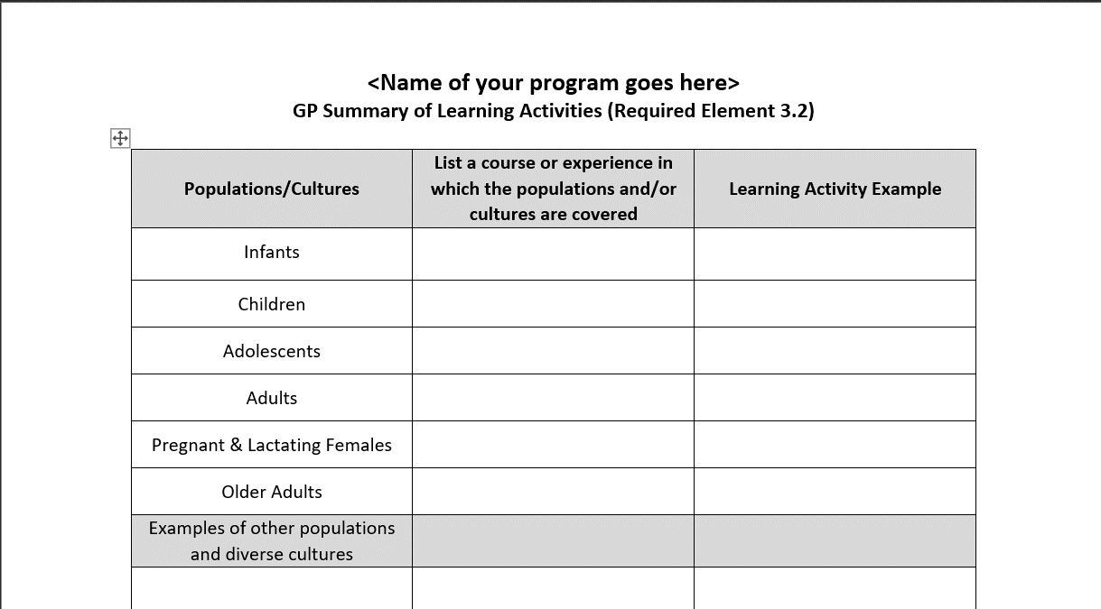
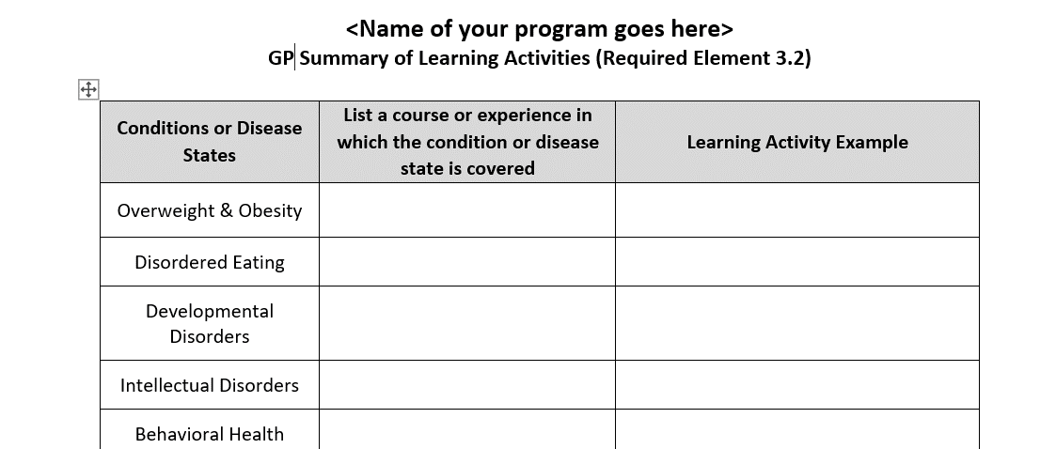
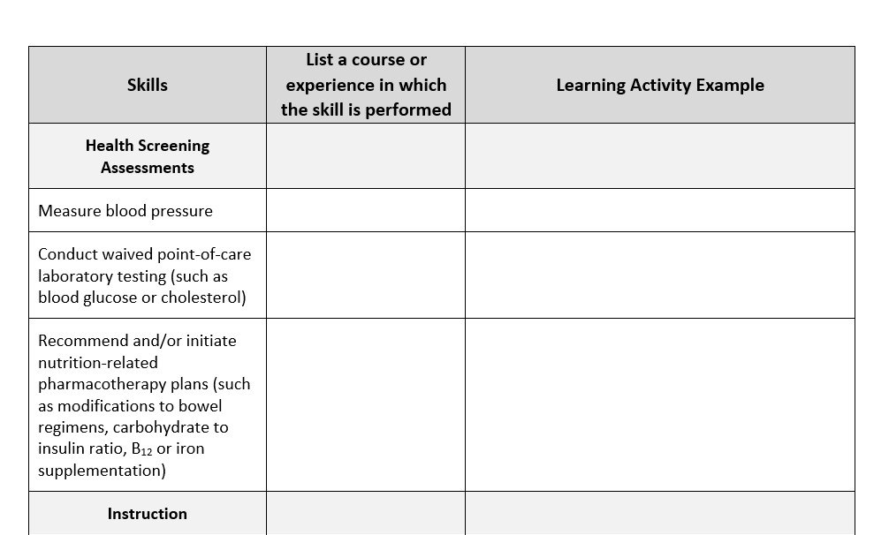
3.2 Summary of Learning Activities Template
Notes:
Here is a copy of The Summary of Learning Activities form where I’ll be indicating, with faculty and preceptor input, which learning activity you are using with each of the populations or cultures each of the conditions, or disease states indicated, or the clinical skills once we implement them.
I’ll remind our faculty that any learning activity example found on this template also needs to be included in the appropriate course syllabus for the identified course.

Slide 39
Standard 3: What to Expect from the Program Director Faculty: Discussion of learning activities to assess competencies (CRDN) Discussion of where performance indicators are covered Preceptors: Program-specific Rotation Description (or help creating) Program-specific rubrics/assessment materials Discuss student and preceptor expectations
R 244
G 135
B 75
#F
©ACEND 2022
Notes:
ACEND asks that I, as program director, be in regular communication with the faculty and preceptors participating in the education of our students. As a faculty member of the program, you should expect that I will discuss the following with you:
-Any learning activities from your course used to assess competencies, and where the performance indicators are covered in your courses
To our preceptors, I am to provide a program-specific rotation description and assessment materials for the students you are training. In some cases, you may be working with me to create these rotation descriptions and assessment materials. You and I should also discuss what is expected of both the student and the preceptor during the rotation so that the appropriate student experience is provided. Even though you may have materials from another supervised practice or supervised experiential learning program, it is important that each program provide its own materials to preceptors. Those of you who are precepting students from multiple programs must use the assessment materials from the program a student attends, not materials from any other institutions you may be working with. This ensures that students from our program all receive comparable educational experiences.

Slide 40
Standard 4: Assessment and Curriculum Improvement
Notes:
Next, we’ll discuss Standard 4 which addresses Assessment and Curriculum Improvement. For those programs on the 2022 standards this would be Student Learning Assessment and for the FEM programs, it would be Competency Assessment.

Slide 41
Program Types and Terminology
CP, DT, FDE: Core Knowledge and Competencies
DI: Core Competencies
DPD: Core Knowledge Requirements
FEM: Competencies and Performance Indicators (PI)
Notes:
Here are some common terminology that you will see based on program type.
CP, DT, FDE: Core Knowledge and Competencies
DI: Core Competencies
DPD: Core Knowledge Requirements
FEM: Competencies and Performance Indicators (PI)

Slide 42
Standard 4
Required Element 4.1:
Assessment Plan
Required Element 4.2:
Data Collection and Analysis
Required Element 4.3: On-going Curriculum Review
Notes:
Standard 4 includes requirements for how programs must assess their curriculum to make sure that their students or interns are achieving the required knowledge and/or competencies.

Slide 43
Required Element 4.1: All program types (2022 Standards)
The program must have a plan for on-going assessment of students’ attainment of core knowledge and/or competencies.
The plan must identify summative assessment methods used, as well as courses and/or supervised practice learning activities in which assessment will occur and the process for tracking individual student’s demonstration of core knowledge and/or competencies.
Notes:
In the 2022 Standards, programs must have a plan or process for ongoing assessment of core knowledge and/or competencies. This plan must identify summative assessment methods used, the course or rotation in which assessment will occur and the process for tracking individual student’s demonstration of knowledge and/or competencies.

Slide 44
Required Element 4.1: FEM Standards
The program must have a plan for assessment of competencies.
The plan must identify summative assessment methods used, as well as courses and/or supervised experiential learning activities in which assessment will occur and the process for tracking individual student’s demonstration of performance indicators/competencies.
Notes:
In the FEM Standards, Required Element 4.1 has only slight wording differences from the 2022 Standards which are shown here in white font. The FEM program must have a plan for the assessment of the competencies and the plan must include the summative assessment method used, the course and/or supervised experiential learning activity, and the process for tracking the individual student's demonstration of the competencies.

Slide 45
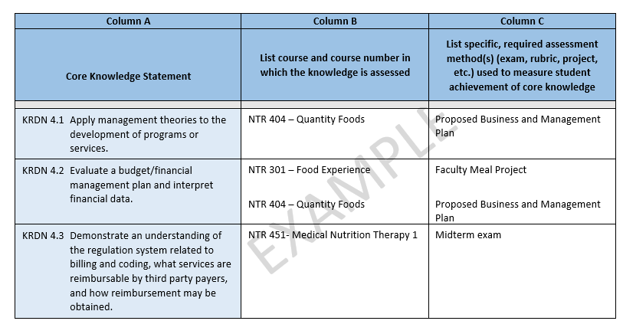
Required Element 4.1
Core Knowledge Assessment Table (DPD)
©ACEND 2022
Notes:
I am required to provide ACEND with a final or culminating assessment (also known as a summative assessment) that is used to measure each of the core knowledge requirements and/or competencies depending on program type. This example is of the core knowledge assessment table to be used by the DPDs. There is a separate core competency assessment table used by DT programs and a third core competency assessment table used by the DI, CP and FDE programs.
For faculty, the expectation is, that if your course is indicated on the assessment table, then the corresponding assessment method is to be included on your course syllabus along with the knowledge requirement or competency that is being measured.

Slide 46
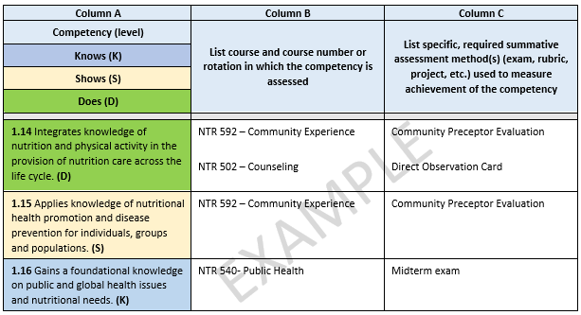
Required Element 4.1
FEM Competency Assessment Table (GP)
©ACEND 2022
Notes:
This is an example of a completed competency assessment table for the FEM Graduate Program. As you can see the structure is the same as the previous slide however, the FEM programs will have the competencies listed in column A and they will be shown at a knows, shows and does level. In all of the tables, column A is written out for programs, and the expectation is that programs will update columns B and C in the table.
Again, for faculty, the expectation is, that if your course is indicated on the assessment table, then the corresponding assessment method is to be included on your course syllabus along with the competency that is being assessed.

Slide 47
Important Notes for FEM programs
Each competency must have at least one assessment, even if all the PIs within a competency are covered in prerequisites.
Assessment may be of prior learning
Program must have a clear policy for evaluation of assessment of prior learning (RE 8.2i)
Enhanced competencies must be covered within the program and not in prerequisites.
Notes:
Here are some important notes for FEM programs only. Each competency must have at least one assessment, even if all the PIs within a competency are covered in prerequisites. In this case, the assessment may be for prior learning and programs would note that in the table. ACEND would then expect to see a very clear program policy for evaluation of assessment of prior learning. I will request input from faculty on the development of this assessment of prior learning policy if we don’t already have one in place.
Also, the enhanced competencies must be covered and assessed within the program and not in pre-requisite coursework. Those enhanced competencies are noted in the table with an asterisk. I will be asking for the assistance of faculty and/or preceptors to identify assessment methods.

Slide 48
Required Element 4.2
The program must document that data on student core knowledge and/or competency attainment are collected, summarized and analyzed for use in curricular review and improvement.
©ACEND 2022
Notes:
The program must document that data on student core knowledge and/or competency attainment are collected, summarized and analyzed for use in curricular review and improvement. Faculty and preceptors will be asked to help me with data collection. Since I need to show ACEND the process our program takes for assessing individual student or intern achievement of the knowledge or competencies, we’ll be reaching out to you to discuss what assignments or activities will be used to assess competencies within the course you teach or the supervised practice or SEL rotation that you lead, as well as details about data collection.

Slide 49
Required Element 4.3
Formal curriculum review must routinely occur and:
Use results of program evaluation and data on student/intern core knowledge and/or competency attainment to determine strengths and areas for improvement
Include input from students/interns and other stakeholders as appropriate
Include assessment of comparability of educational experiences and consistency of learning outcomes when different courses, delivery methods (such as distance education), or supervised practice sites are used to accomplish the same learning objectives
Result in action to maintain or improve student/intern learning
Notes:
Programs are required to review results of program evaluation and data analysis, as well as feedback from students and other stakeholders. Then we are to identify strengths and areas of improvement for the program. Finally, we are to develop actions that will be taken to improve the program based on this analysis. You may be asked to provide feedback about the program’s curriculum or, if you are part of the curriculum committee or advisory board for our program, you may be asked to review feedback and assist with data analysis.
We may also request your feedback about the program’s curriculum.

Slide 50
Standard 5: Faculty and Preceptors
Notes:
Standard 5 discusses requirements around faculty and preceptors. Please pay special attention to this standard; it’s all about you!

Slide 51
Required Element 5.1
Program provides evidence that:
The number of qualified and appropriately credentialed faculty and preceptors/practitioners is sufficient to achieve program objectives and student/intern outcomes
Notes:
Programs must have a sufficient number of qualified faculty and preceptors. You will be asked to provide the depth and breadth of learning activities required within the curriculum.
Not all faculty and preceptors need to be RDNs or NDTRs, but they need to be appropriately credentialed in the area they’re teaching. For example, a nurse who is a certified diabetes educator would be an appropriate preceptor in an outpatient diabetes clinic, but probably not in the NICU. Another example may be that a school food service director may not be an RDN or NDTR but may hold the School Nutrition Specialist, or SNS, credential.

Slide 52
Required Element 5.2a
Faculty within the academic unit must meet the sponsoring organization‘s criteria for appointment,
have sufficient education in a field related to the subject in which they teach OR
must meet the institution’s policy for education and/or equivalent experience
Notes:
This Required Element relates to program faculty within the academic unit. Our faculty must meet the sponsoring organization’s criteria for appointment and have sufficient education in a field related to the subject they are teaching OR they must meet our institution’s policy for education.

Slide 53
Required Element 5.2b and 5.2c
b) must show evidence of continued competence appropriate to their teaching responsibilities
c) must be provided with orientation to the mission, goals, and objectives of the program, the ACEND standards and knowledge/competencies;
must be trained in the use of distance education pedagogy
Notes:
Although this slide and the next pertain to faculty, I’d like our preceptors to listen closely as these mirror the preceptor requirements found in Required Element 5.3 of this Standard.
Program faculty, including the program director, and preceptors must show evidence of continued competence appropriate to their teaching responsibilities. This can be demonstrated in a CV or resume. If you, as faculty, are an RDN, the credential, in and of itself, is not an indication of competence to teach students or interns. You’ll be asked to demonstrate how you are keeping up to date in the area in which you are teaching, or, for our preceptors, the area in which you provide supervised practice or SEL experiences to our students or interns.
Also, the program must provide faculty and preceptors with orientation that includes information about the program’s mission, goals, objectives and the ACEND standards, knowledge and competencies. This is to be provided to all faculty who teach in the program and reside in the program’s academic unit or department. While this does not pertain to faculty outside of the academic unit, it does apply to our preceptors.
The following does not pertain to our preceptors. Faculty within the academic unit who teach in the program are now required to be trained on distance education pedagogy as well. The idea is that all programs are able to seamlessly transition to online instruction if needed. This is a requirement for all program faculty even if you do not provide distance education. The use of the internet and other technologies are more and more prevalent even in traditional in-person or on-campus courses. The program may train faculty by using trainings offered by the university or institution. Examples of training include effective use of an online learning management system, utilizing a hybrid classroom approach, or team-based learning which utilizes internet or other technologies for course delivery. So, faculty, please understand that, even if you are not currently offering on-line or distance education courses, the program is required to make sure you have received this training.

Slide 54
Required Element 5.2d
d) Must be trained on strategies to recognize and monitor biases in self and others and reduce instances of microaggression and discrimination
Notes:
Another area in which programs are required to ensure training for faculty within the academic unit and our preceptors includes strategies to recognize and monitor biases in self and others as well as reduce instances of microaggression and discrimination. This training can be provided by the institution, where the faculty are employed or where the preceptors are employed and does not necessarily have to be provided by the program. However, our program must ensure that our faculty and preceptors are receiving training of some sort on these topics. We may choose to offer you the ACEND webinar series, which is found on the ACEND website under the Diversity, Equity and Inclusion section.

Slide 55
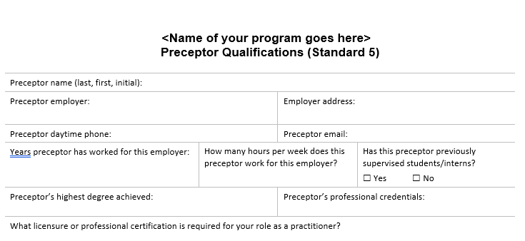
Required Element 5.3: All Program Types; except DPDs
Notes:
The program will request from all faculty and preceptors your resume or CV or for preceptors, we may ask you to fill in a form such as this one, which is a preceptor qualifications form.

Slide 56
Standard 5: What to Expect from the Program Director Request for resume, CV or similar Request for recent continuing education endeavors Training Materials -Review of Program mission, goals and objectives -Review of ACEND and Standards -Explanation of CRDNS/CNDTs – 2022 Standards -Explanation of CRDNS/PIs – FEM Standards Preceptor Handbook or similar
R 244
G 135
B 75
#F
©ACEND 2022
Notes:
To summarize, you can expect me, as program director, to reach out to you periodically to request an updated resume and a list of recent continuing education. I’ll also be providing periodic training materials, especially if there are any changes to the ACEND Standards or curriculum requirements, or changes to the program. Finally, I’ll provide our preceptors with expectations of their role and responsibilities in the program.

Slide 57
For more information
Visit the ACEND Website for:
2022 ACEND Accreditation Standards
FEM ACEND Accreditation Standards
Guidance Information
Listing of accredited programs
Updates about accreditation-ACEND UPdate
http://www.eatrightpro.org/acend
R 244
G 135
B 75
#F4874B
Notes:
The ACEND website has a variety of resources for me as the program director but also for preceptors and faculty. Please visit the website to obtain the latest updates and documents from ACEND.

Slide 58
Thank You!
ACEND’s contact information:
Email: ACEND@eatright.org
Phone: 800/877-1600, ext. 5400
Mail: 120 South Riverside Plaza
Suite 2190, Chicago, IL 60606-6995
ACEND Website: http://www.eatrightpro.org/acend
R 244
G 135
B 75
#F4874B
Notes:
Thank you for participating in this training. If you have any questions, comments or concerns, please contact me or feel free to contact ACEND.

