Slide 1
A Guide to DICAS: Dietetics Inclusive Centralized Application Service – Overview for DPD Applicants

Slide 2
What is DICAS?
DICAS is a web-based application service that simplifies the dietetics application process by allowing applicants to apply to multiple programs with one application.
NOTE: For the 2024-2025 application cycle (programs accepting applications from fall 2024 through July 2025), some coordinated and graduate programs may not be using DICAS. If the program you are interested in does not appear in DICAS, check the program’s website for directions on how to apply or contact the program director. For the 2025-2026 cycle, all supervised practice programs will be required to use DICAS.

Slide 3
Setting Up Your Profile
Visit DICAS to create your account
There is no cost to the applicant to create an account
Once you create your account, you will first be asked whether you have a DPD Verification Statement or a Declaration of Intent from a Didactic Program in Dietetics (DPD). This initial question will determine future questions and documentation required in the application.

Slide 4
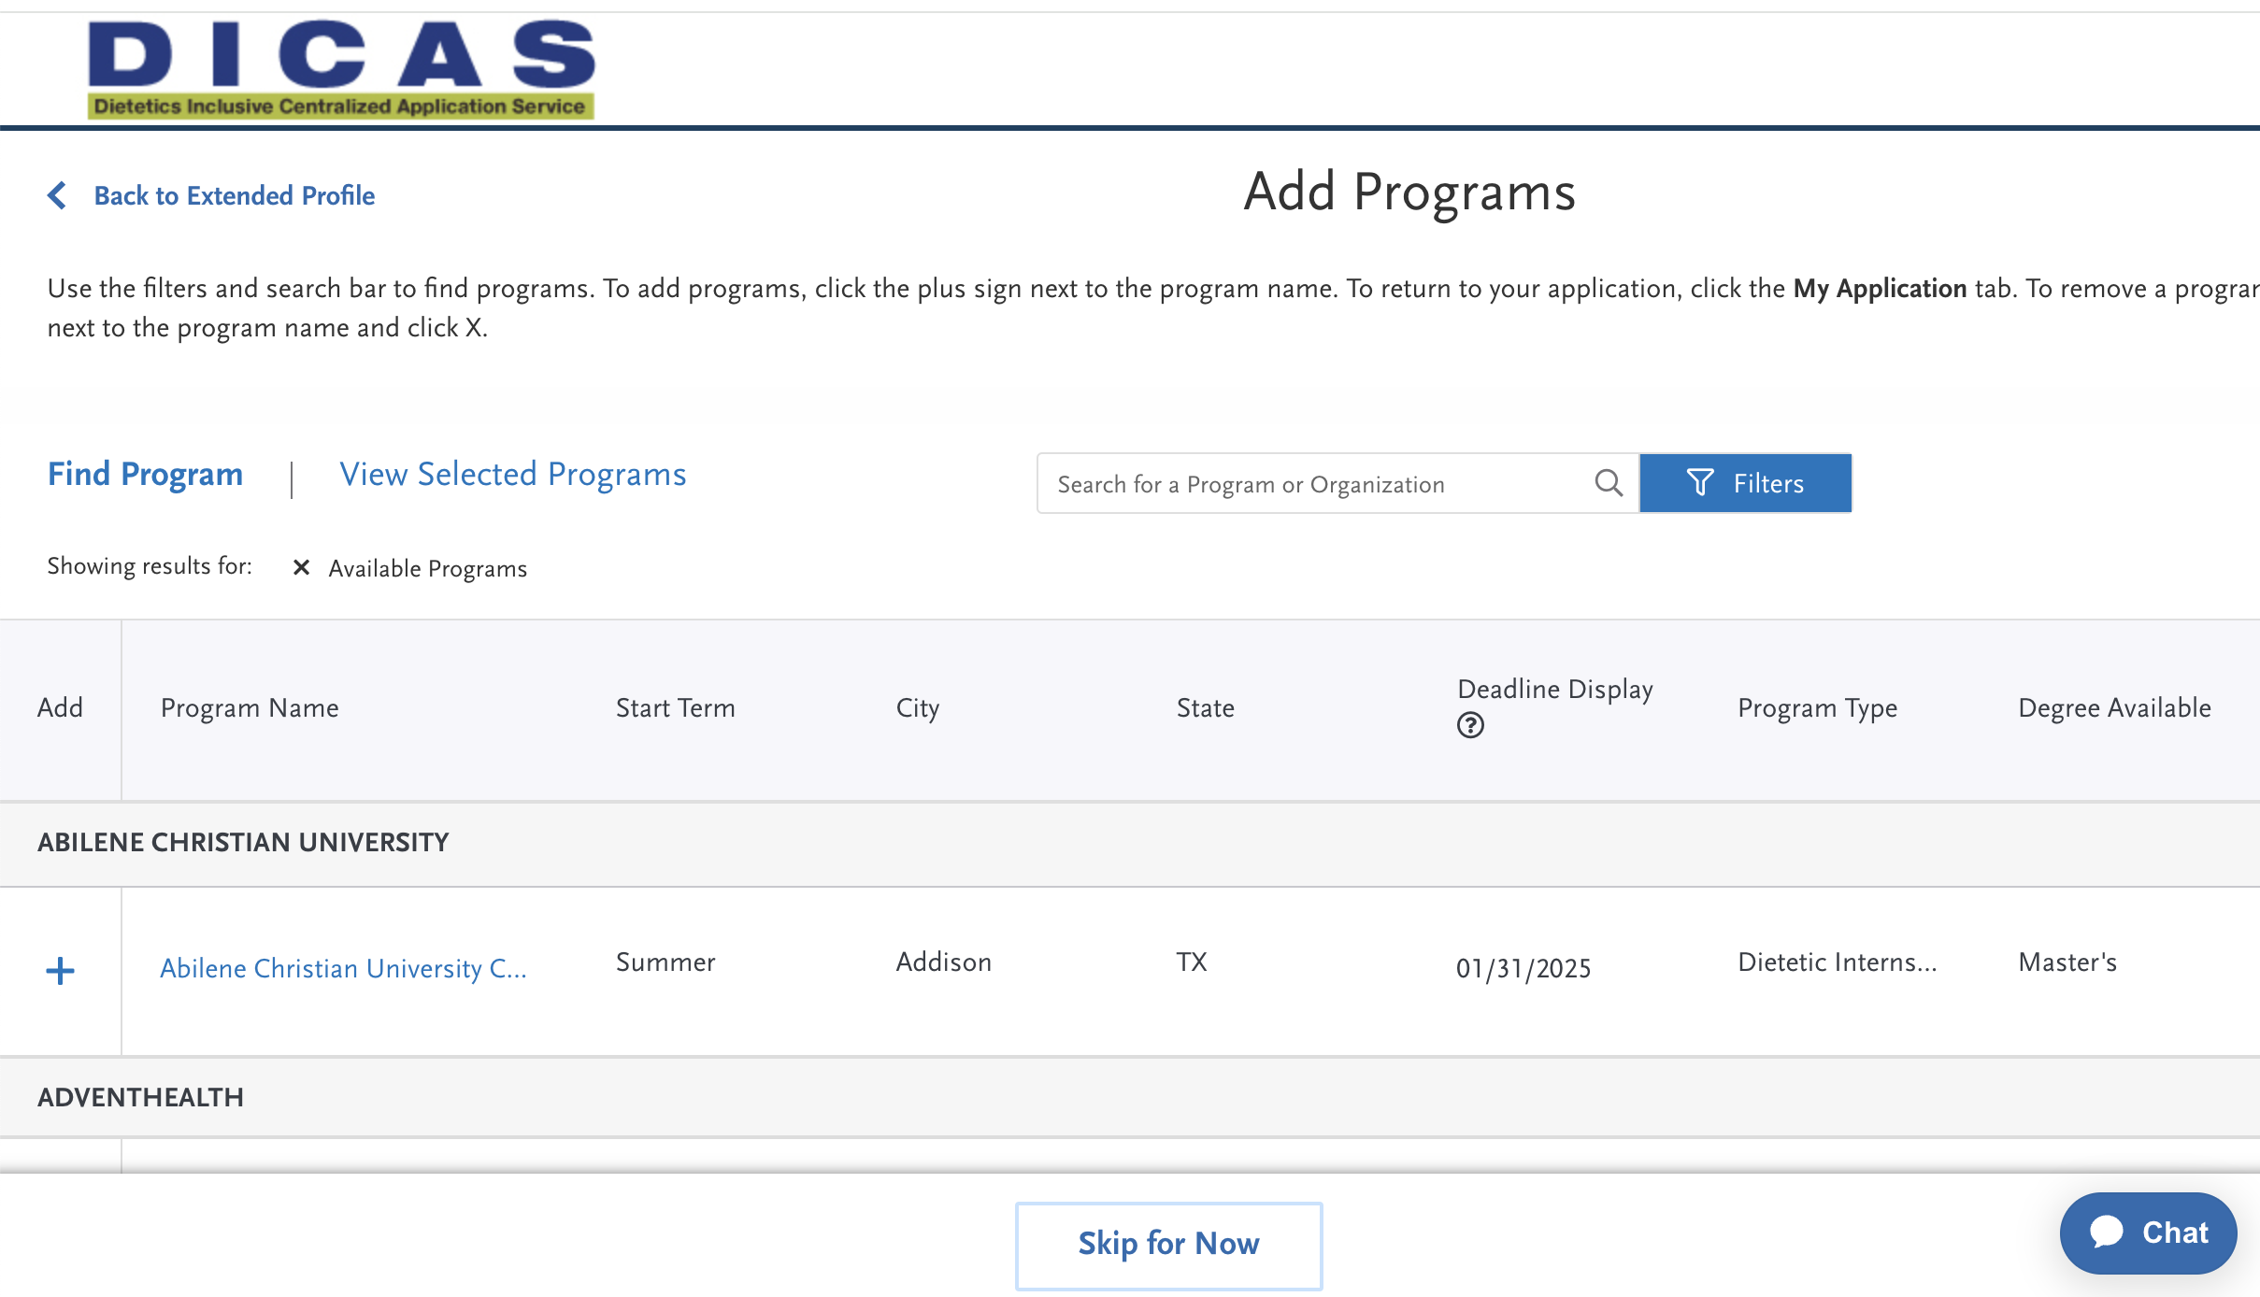
Selecting Programs to Apply To
Use the filters and search bar to find programs
To view basic program information, click on the program name
To add a program to apply to, click on the plus sign next to the program name
Test University

Slide 5
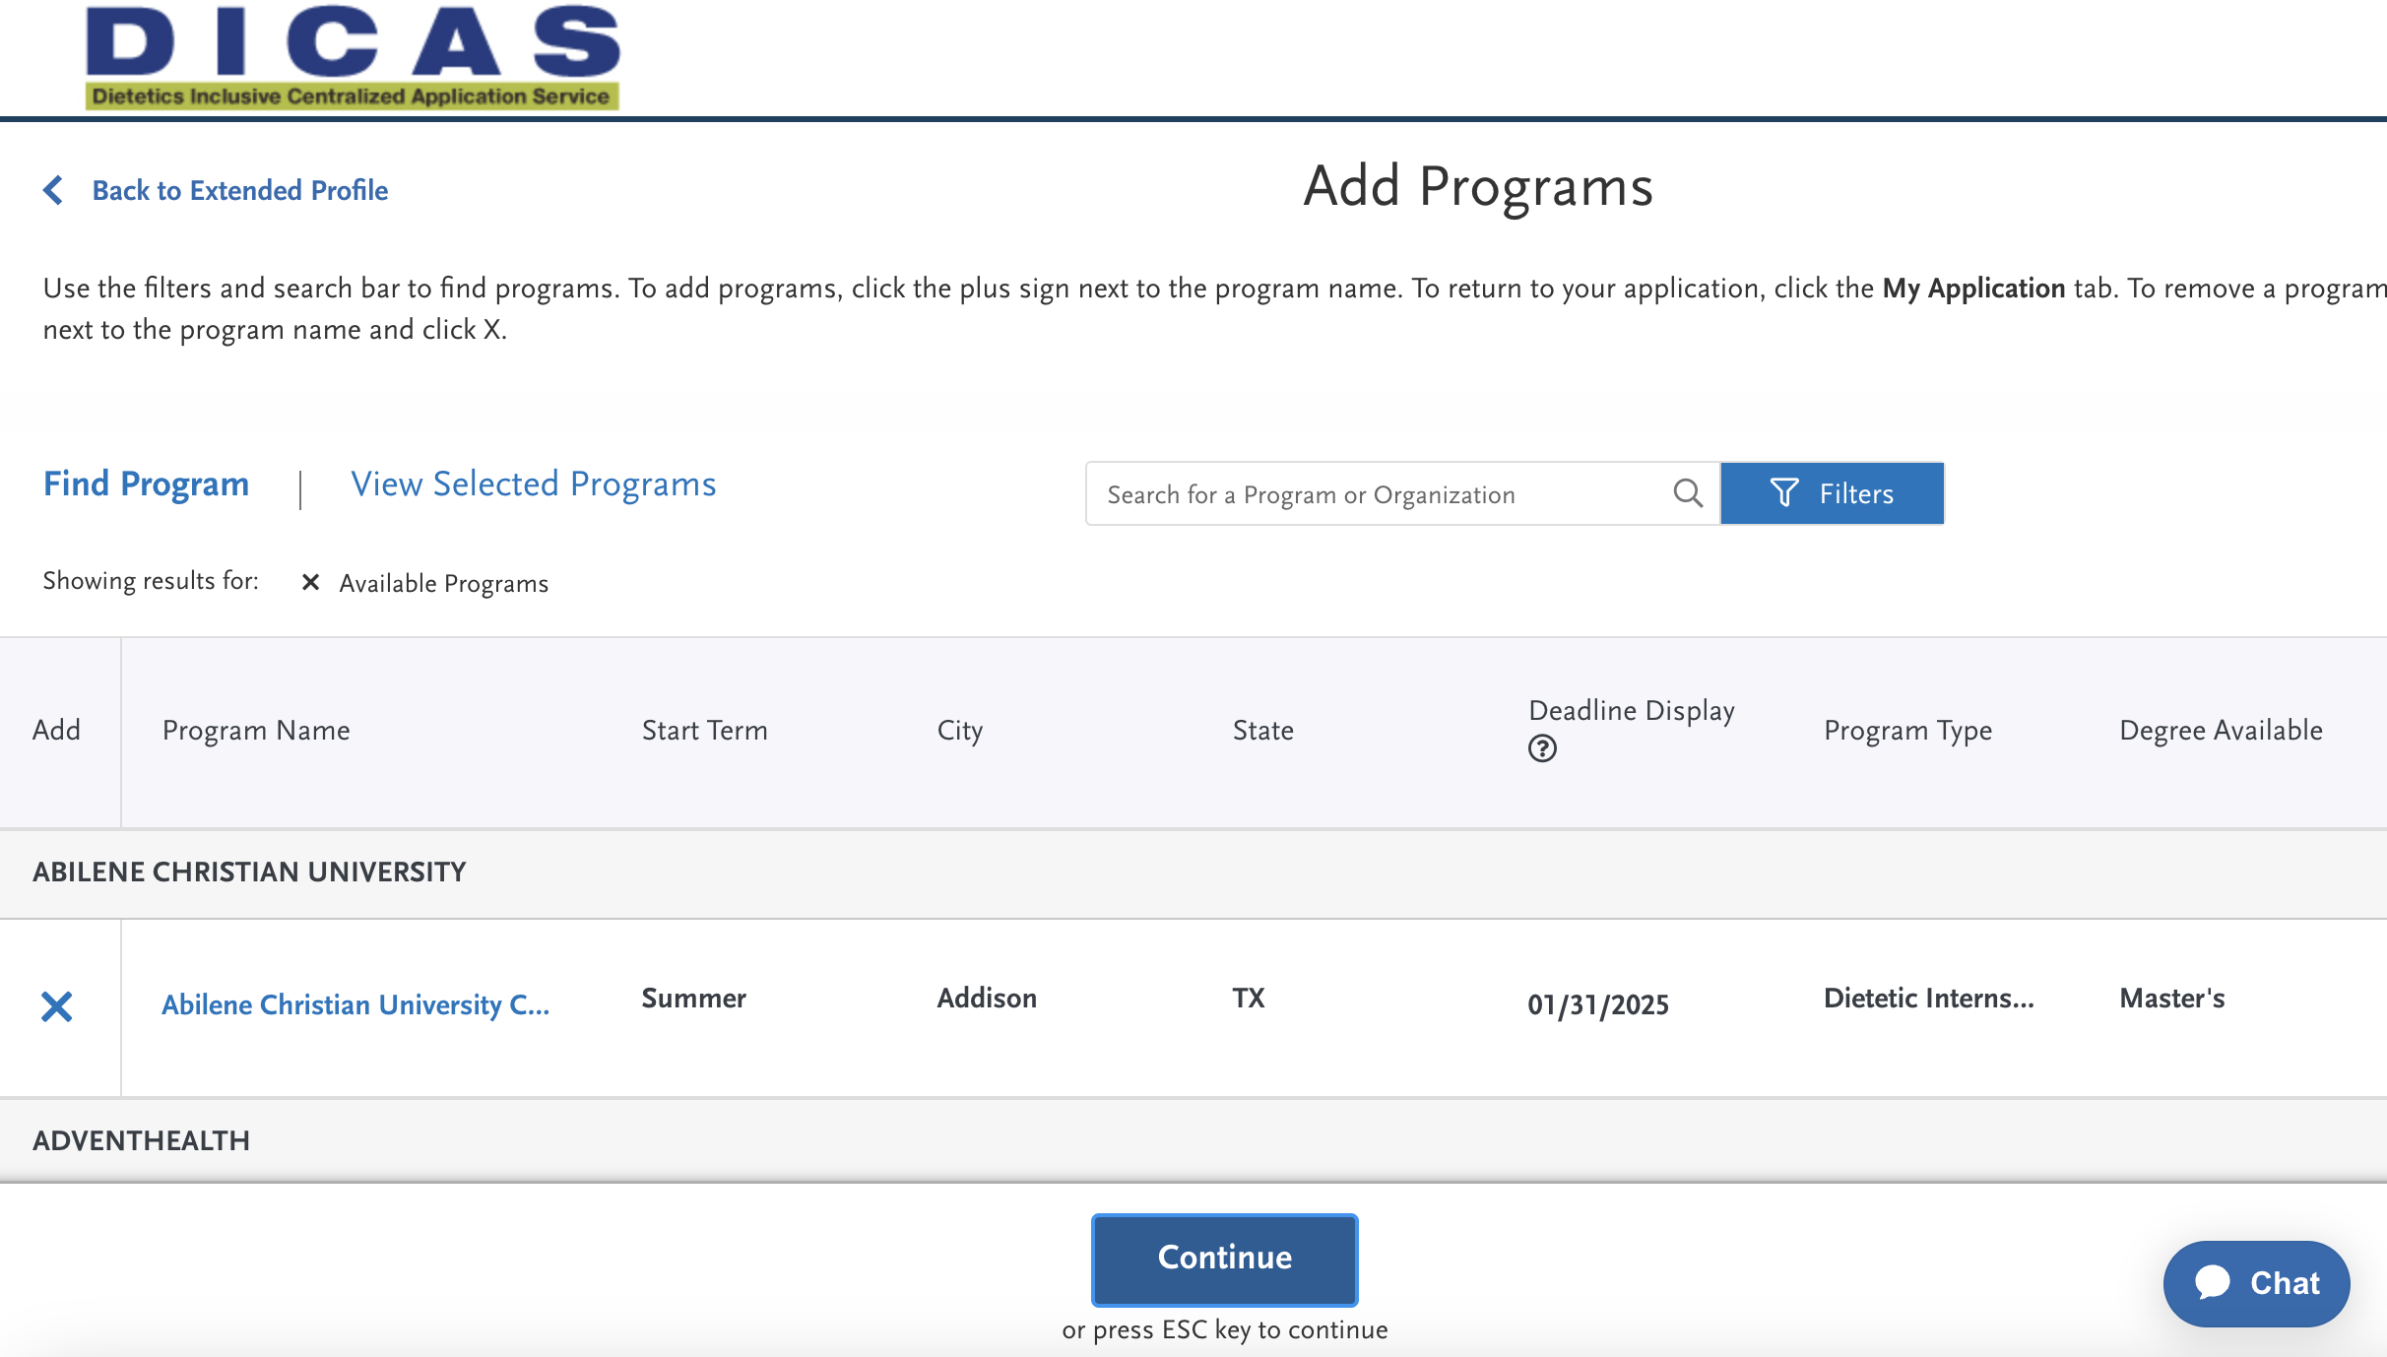
Selecting Programs to Apply To
To remove a program you no longer wish to apply to, hover your cursor over the checkmark next to the program name and click the X
Test University

Slide 6
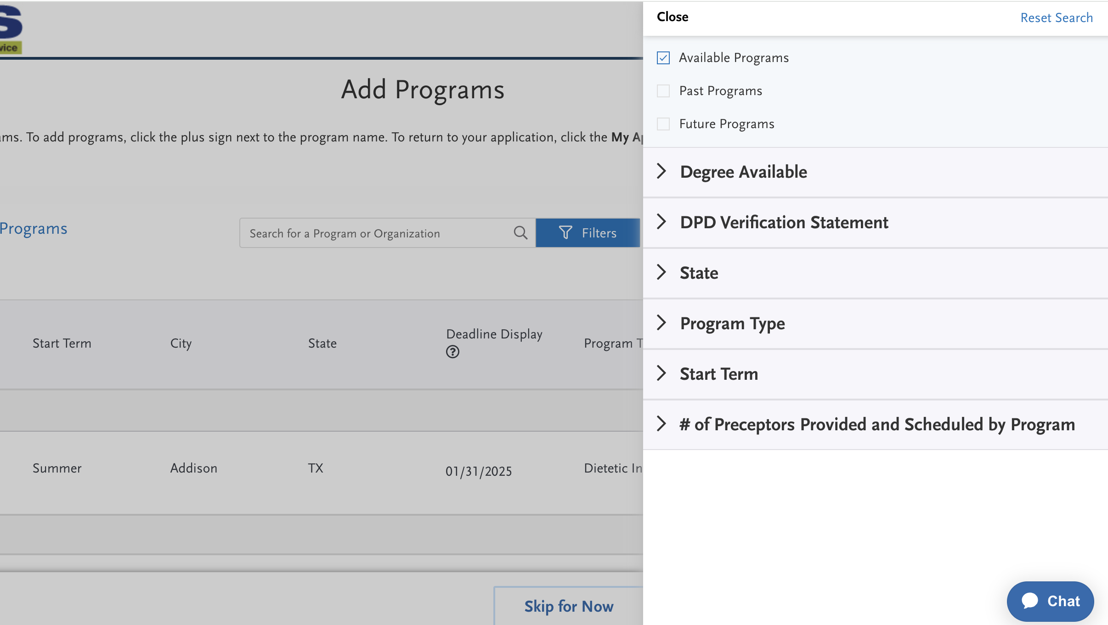
Selecting Programs to Apply To
The DICAS search filter can be used to narrow your search
To be able to see programs with application open dates in the future, check the Future Programs button

Slide 7
Applying on DICAS: An Overview
Your DICAS application is split into 4 sections. You can complete the first 3 sections before selecting a program

Slide 8
Personal Information
In this section, you will provide basic background information about yourself
Biographic Information
Contact Information
Race & Ethnicity
Citizenship Information
Other Information
Release Statement

Slide 9
Academic History
In this section, you will provide information about your academic performance
You must input all of your undergraduate and graduate information (if applicable) from all previously attended schools

Slide 10
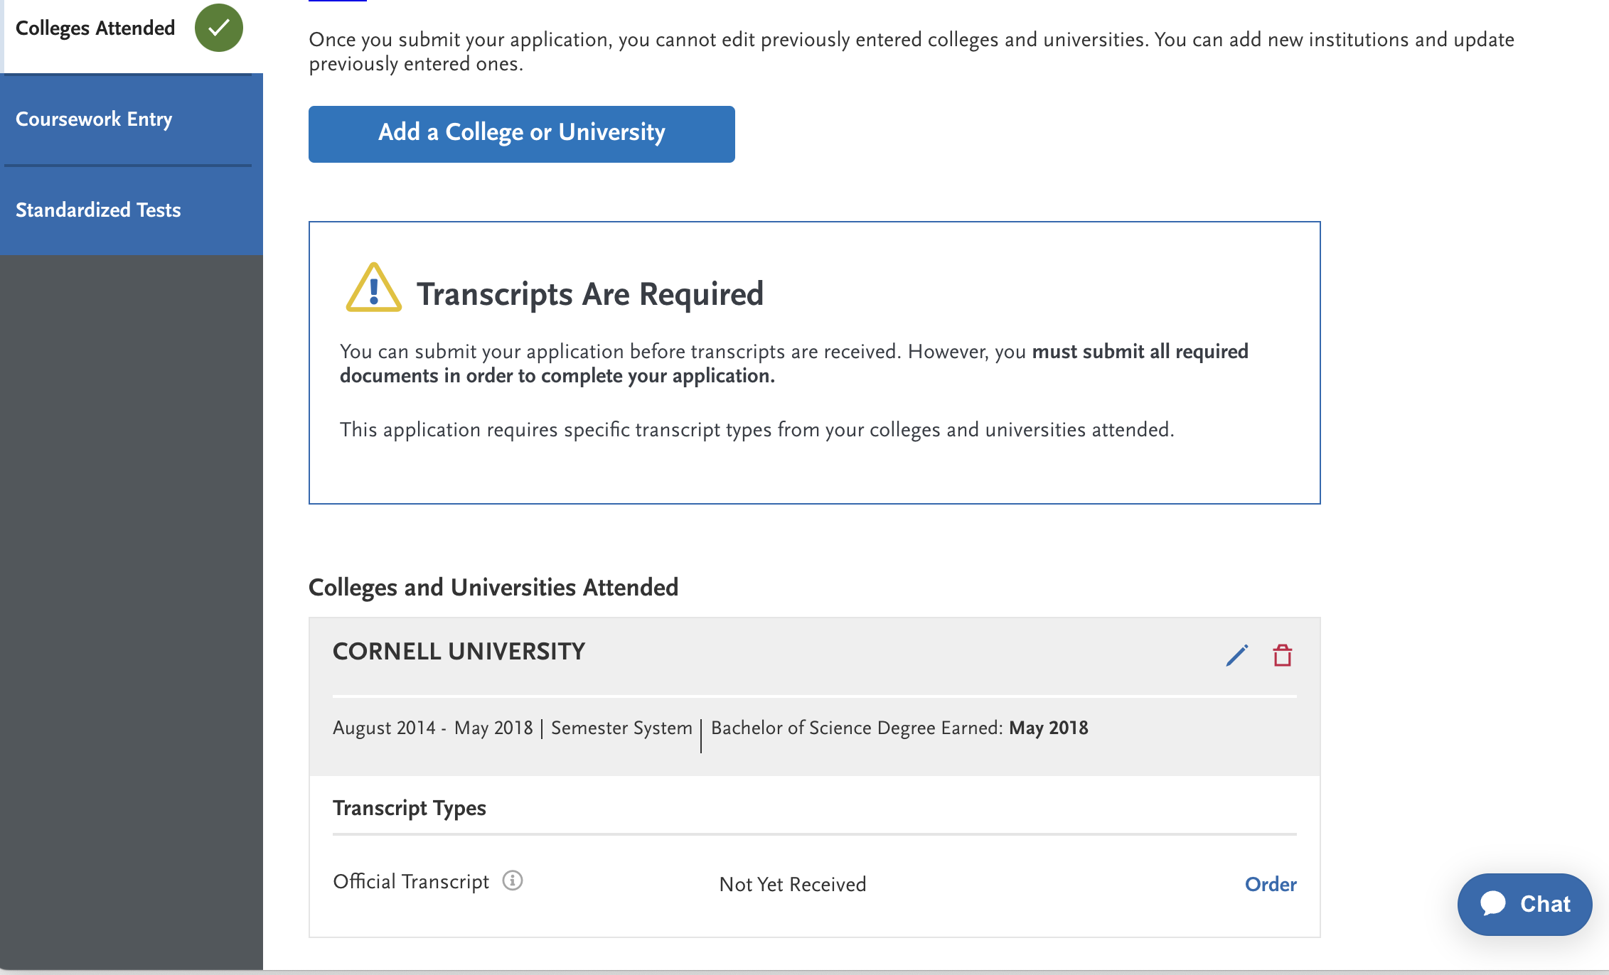
Academic History
You must submit an official transcript for every college you previously attended
You can order each official transcript directly through DICAS
XXX

Slide 11
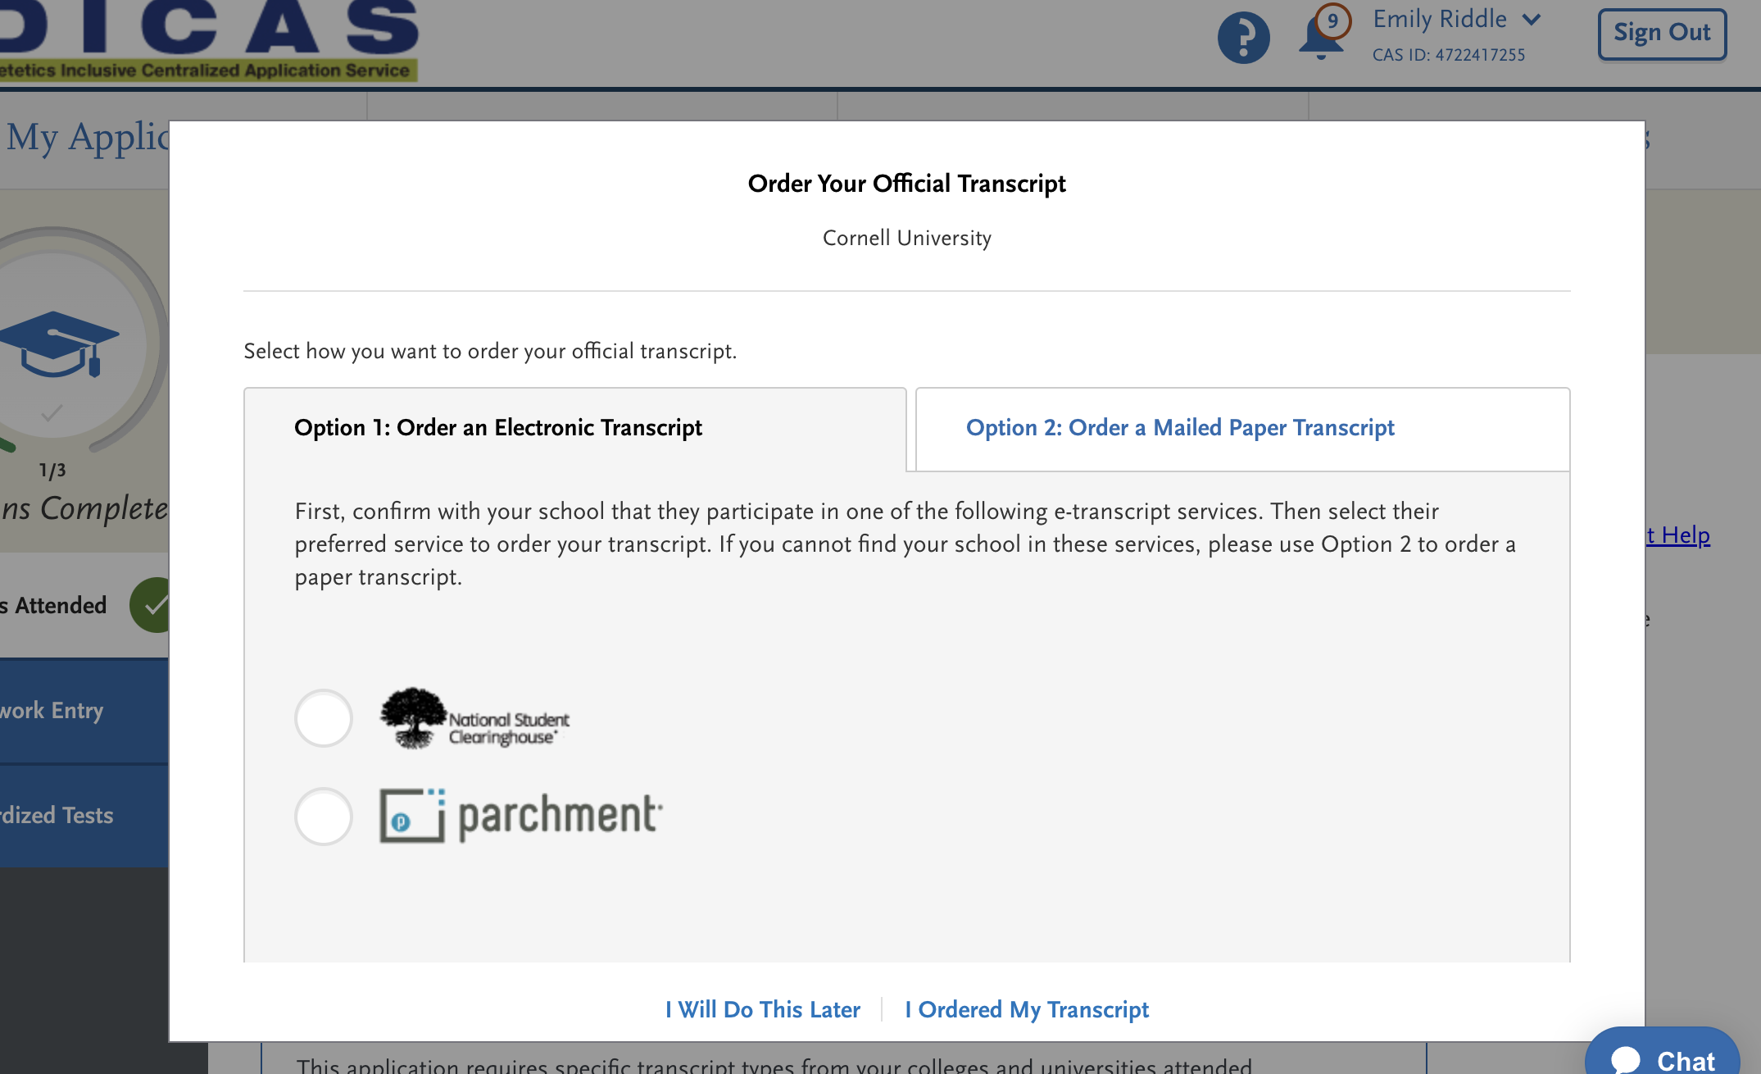
Academic History
Confirm with your school whether they participate in the National Student Clearinghouse or Parchment e-transcript services
If they participate in either of these services, use Option 1 to order an electronic transcript
If they do not participate in either of these services, use Option 2 to order a paper transcript

Slide 12
Academic History
Entering coursework takes a few steps and can be time consuming so plan accordingly
If you get stuck, you can watch the video located in the bottom left corner of the Coursework Entry screen
Coursework needs to be reviewed for special conditions (labs, AP courses, DPD classification) before it is complete
If you are entering DPD coursework, you must enter all future and planned coursework related to your DPD

Slide 13
Supporting Information
This section of the application asks for information related to your:
Achievements
Experiences
Memberships
Licenses and certifications
Documents (e.g. CV/Resume, DPD Course List Form obtained from DPD Director)
DPD verification statement (if you indicated that you have one) or Declaration of Intent (if you are still completing a DPD)

Slide 14
Program Materials
Once you have selected programs of interest, the programs you selected will be found in this section
Each program has the option to ask for additional information or documents related to their application process
Information about those who will write your letters of recommendation will be collected in this section

Slide 15
Submitting Your Application
You can submit your applications once they are complete
When you submit, you will pay an application fee to DICAS and possibly to the programs you are applying to, so check each program’s website for payment information
Applicants may also ask programs for any fee reductions or waivers

Slide 16
Submitting Your Application
When you are ready to submit your application, navigate to the Submit Application tab
You can submit one application at at time or all at once

Slide 17
Checking Status
Once you have submitted your application, use the “Check Status” tab to monitor the status of your application
Here you can monitor whether all transcripts, DPD documents, and letters of recommendation have been received

Slide 18
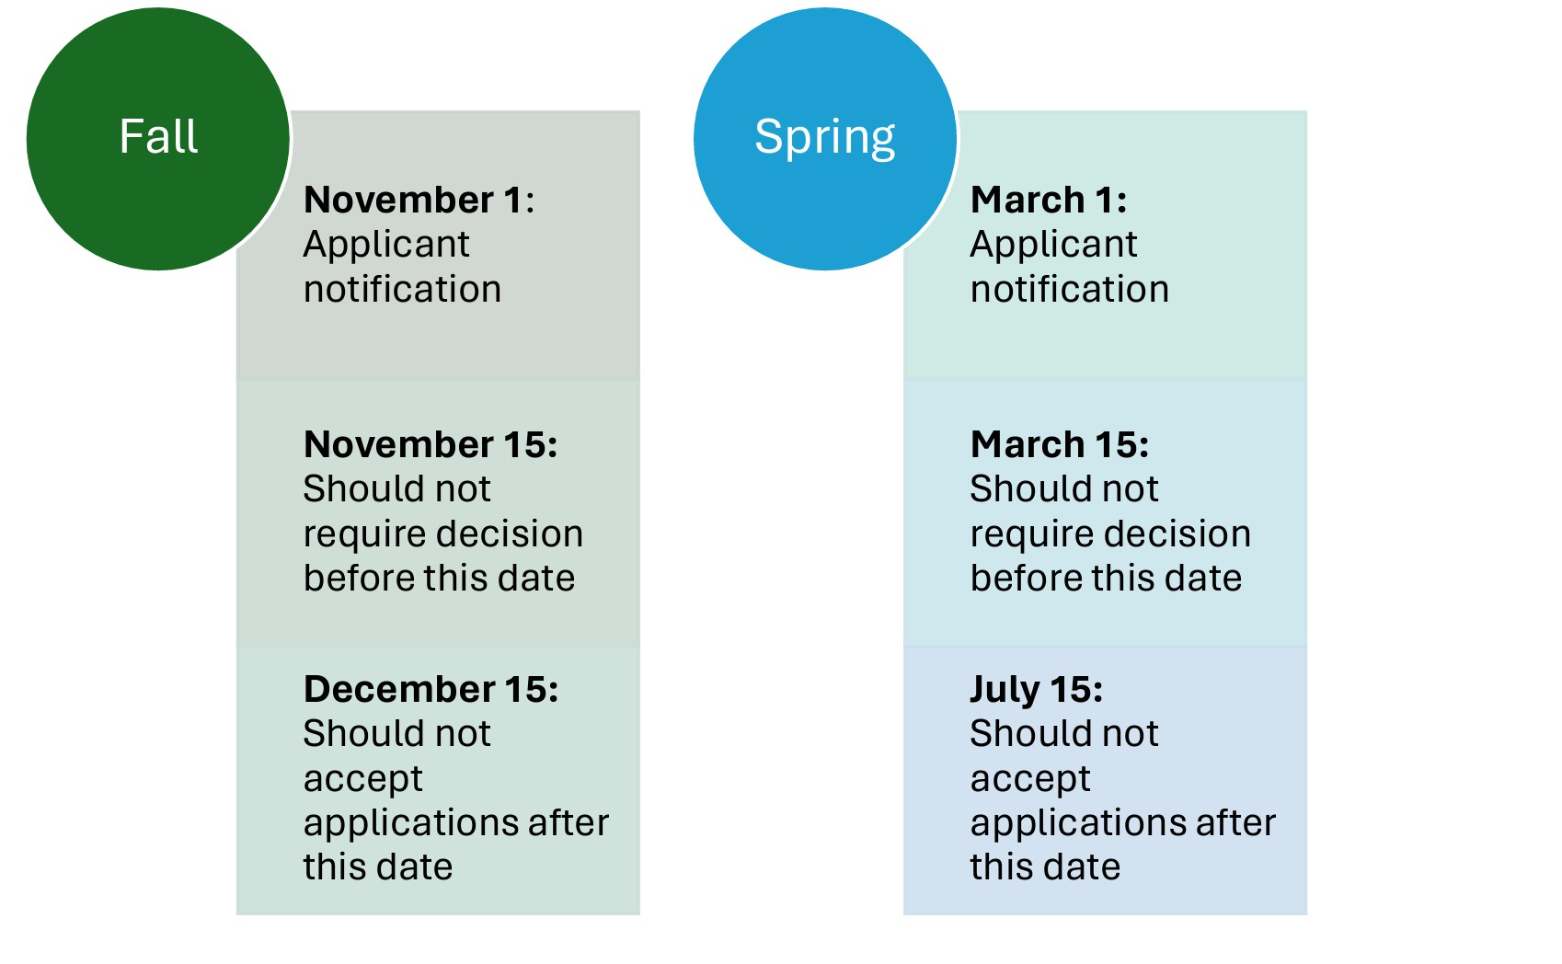
Important Standardized Dates
The DICAS portal opened on Aug 5, 2024
Application deadlines will vary by program
Regardless of the program’s application deadline, all programs must notify applicants of decision by Nov 1/March 1
Applicants have until Nov 15/March 15 to respond to a program’s decision and pay any required deposit
Some programs may use a waitlist
Source: DICAS Applicant Information Handout

Slide 19
Applying to a Program at your Current Institution
For applicants applying to programs within the same institution (e.g. DPD students applying to the DI within the same university), those programs may not have to follow the Application Process Due Dates
This may allow for an “early decision” option for students interested in continuing their education and training at the same institution
If you are applying to a program within your current institution, be sure to contact the program in your institution to obtain due dates

Slide 20
Receiving Multiple Offers
You may not be enrolled in more than one program at any time
In fairness to other applicants and nutrition and dietetics programs, if you have decided before November 15 (Fall) or March 15 (Spring) not to attend a program that has offered you admission, promptly withdraw your application from the program(s) by contacting the program director
Once you have accepted an offer, if you were offered admission to other programs, you must contact the program director(s) to decline offer(s). This allows waitlisted applicants to be given offers

Slide 21
Receiving Multiple Offers
If you receive and accept an alternative offer after you have already accepted an offer, you must rescind/withdraw your acceptance at the program where you had previously accepted an offer within 24 hours of accepting the offer at the new program

Slide 22
Applicant Training Video and Resources
DICAS Applicant Video on Vimeo
PDF DICAS Cycle Applicant Tips
DICAS Applicant Help Center - Liaison (liaisonedu.com)
DICAS Applicant Information Handout

Slide 23
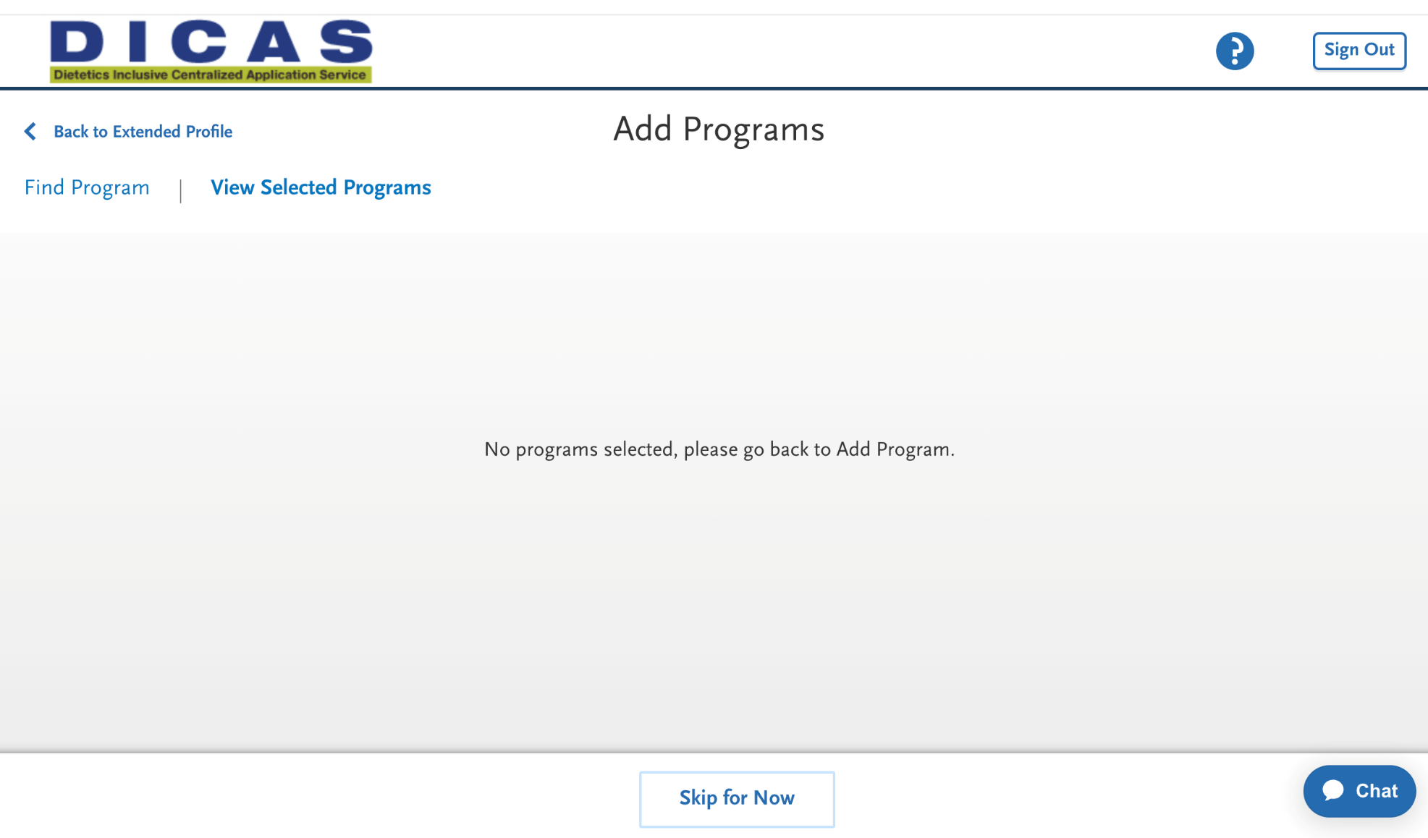
DICAS SUPPORT
DICAS has a chat box that can be accessed in the bottom right corner of the screen.
If you need assistance with the centralized application, please contact DICAS customer support at 617/612-2855.
If you have any general questions about applying to dietetics programs, contact ACEND.

